Slide 1



WORK
LIFE BALANCE
Name – Krishna Nand Yadav
UID – 22MCA20324
Course – Master of Computer Applications
Subject – Soft Skills II
Class – MCA 1-B
Semester – 3rd

Slide 2
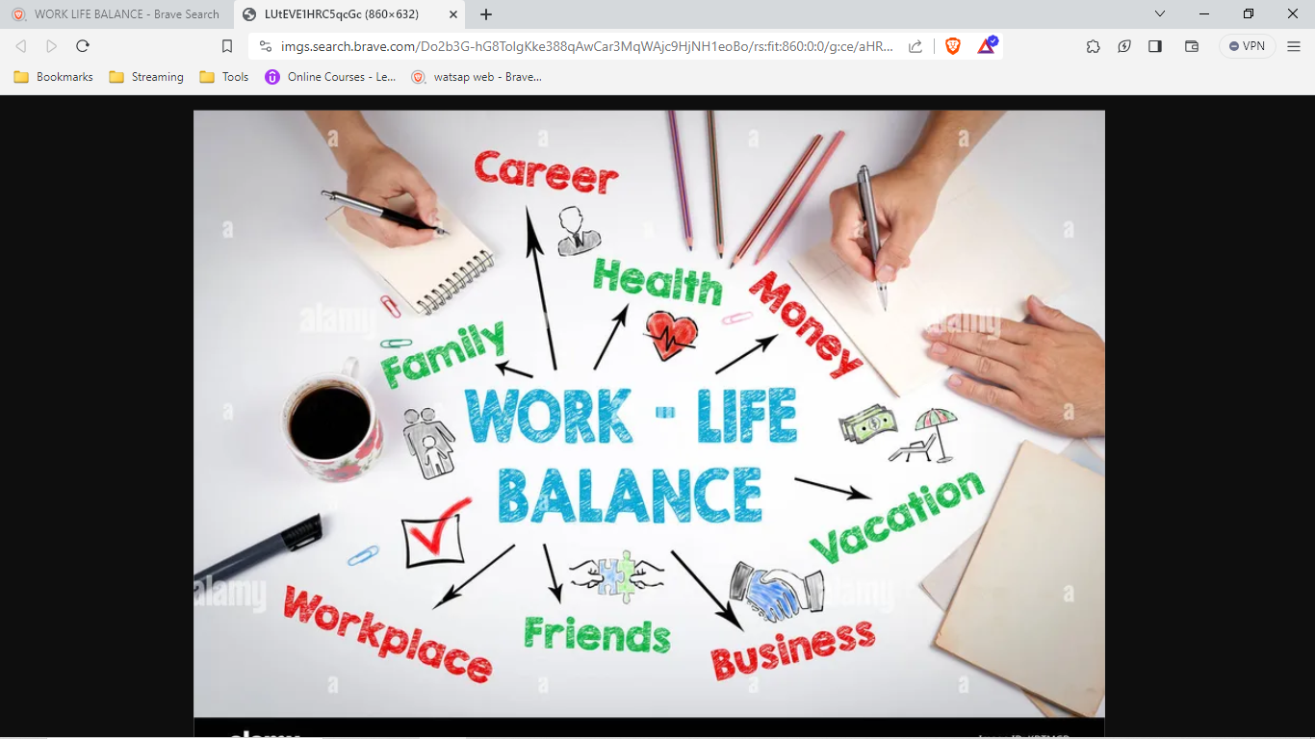
WORK
LIFE
BALANCE

Slide 3

Work-Life Balance
Work-life balance is the equilibrium between professional responsibilities and personal well-being, ensuring individuals lead fulfilling lives both in and outside the workplace.

Slide 4
Understanding Work-Life Balance
Setting Boundaries: Setting boundaries involves delineating specific times for work and personal life to prevent one from encroaching on the other, fostering a healthy balance.
Prioritizing Well-Being: Prioritizing well-being encompasses physical, mental, and emotional health, acknowledging that a balanced life contributes to sustained productivity and happiness.
Effective Time Management: Effective time management involves allocating time efficiently to work tasks and personal activities, optimizing productivity and minimizing stress.
Flexible Work Arrangements: Flexible work arrangements allow for variations in work hours or location, accommodating individual needs and promoting a harmonious work-life balance.
Quality Over Quantity: Emphasizing quality over quantity entails focusing on meaningful and impactful work, rather than simply logging long hours, enhancing overall life satisfaction.

Slide 5
Strategies for Achieving Work-Life Balance
Regular Breaks and Vacations: Regular breaks and vacations are essential for rejuvenation, providing the necessary mental and physical distance from work to maintain a balanced lifestyle.
Communication and Boundaries at Work: Communication and boundaries at work involve open dialogues with colleagues and supervisors about personal limits, fostering a supportive work environment.
Mindfulness and Self-Care: The activities that promote relaxation, stress reduction, and self-awareness, contributing to overall well-being.
Family and Social Connections: Family and social connections are integral to a balanced life, fostering meaningful relationships that provide emotional support and fulfilment.
Continuous Reflection and Adjustment: Continuous reflection and adjustment involve regularly assessing one's priorities and adjusting commitments to align with evolving personal and professional needs

Slide 6
Thank you!

